Slide 1



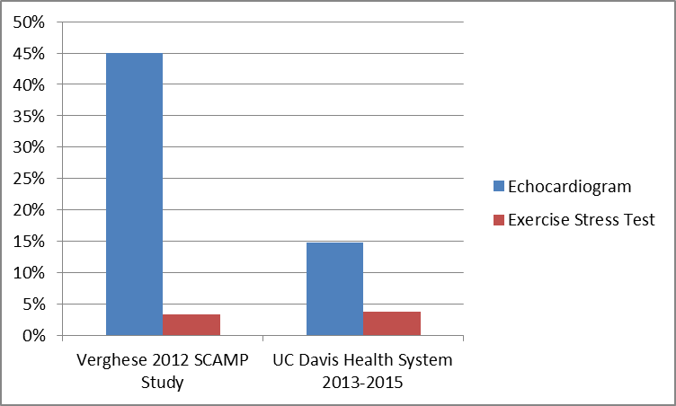
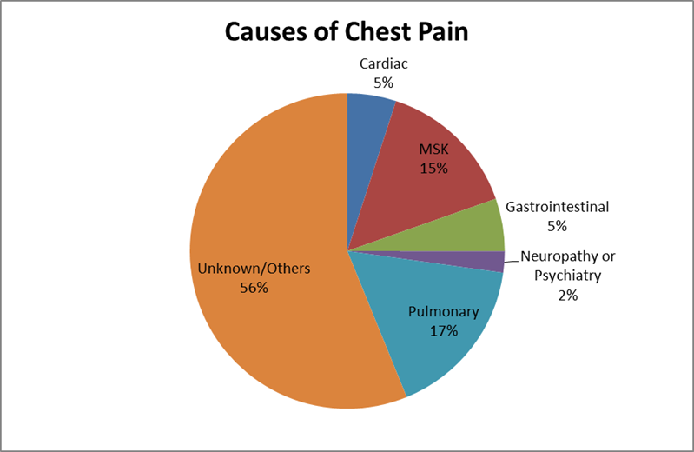
Pediatrics Chest Pain and Utilization of Exercise Stress Test and Echocardiogram
Keng Lam, B.A.1, Madan Dharmar, M.B.B.S., Ph.D.1 and Stuart Berger, MD1.
1Department of Pediatrics, UC Davis, Sacramento, CA, United States.
Introduction
Chest pain is a common presenting complaint amongst pediatric patient. Unlike adults, the majority of diagnoses are non-cardiac. Echocardiography and exercise stress testing (EST) are often used to rule out a cardiac etiology. The utilization rates for these studies in pediatric patients have not been studied at the University of California Davis Health System (UCDHS). The results from this study will be used to help us understand current resource utilization, reasons for the utilization decisions, and to potentially support the implementation of Standardized Clinical Assessment and Management Plans (SCAMPs) at UCDHS.
Results
28 patients (3.79%) had an EST (most in conjunction with echocardiogram) and 109 patients (14.75%) had an echocardiogram without EST. There were no statistical differences (P>0.05) in race/ethnicity, gender, languages spoken, and age ranges with regard to the ordering and performance of the testing. The most common etiologies for the chest pain in this cohort were unknown (56%), pulmonary (17%), and musculoskeletal (15%).
All 5 surveyed pediatrics cardiologists chose not to perform testing without a specific indication in the patient history. Lack of easy access to EST testing as well as incomplete data (inability to easily perform breath-by-breath analysis) may be reasons for a decreased incidence of EST testing.
Methods
We reviewed records of 739 patients, aged 0-17, who presented to UCDHS with a chief complaint of chest pain during a two year period from February 1, 2013 to February 1, 2015. The data reviewed included patient demographics, the clinical diagnosis, and whether an echocardiogram and an EST were performed.
We also surveyed all 5 pediatrics cardiologists on the UCDHS faculty to specifically evaluate reasons for their decision-making with regard to ordering an echocardiogram and/or EST in this setting.
Figure 1. UCDHS results compared to a Children’s Hospital Boston SCAMP Study
Conclusions
The utilization of echocardiography and EST at UCDHS for pediatric patients with chest pain was lower than what is described in the literature. Formal implementation of SCAMPs may not always be necessary to thoughtfully implement a cost-effective utilization strategy. UCDHS is in the process of updating the exercise stress lab including improved access for pediatric patients as well as the ability to get data related to breath-by-breath analysis.
Acknowledgments
Dr. Stuart Berger and Madan Dharmar (mentors)
UC Davis CTSC Clinical Research Center
UC Davis Medical Student Fellowship Program
Figure 2. Common diagnoses for chest pain

